Slide 1
Apache Camel – Training - Day-3
Documented By
Manikanta Jakkampudi

Slide 2
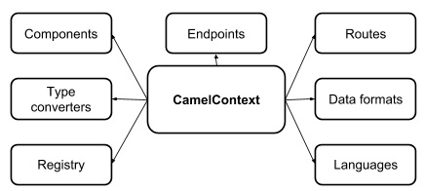
Camel Context
Camel Context

Slide 3
Camel Core concepts …continued
COMPONENT
■ Components are the main extension point in Camel.
■ To date, there are over 80 components in the Camel ecosystem that range in function from data transports, to DSLs, data formats, and so on.
■ From a programming point of view, components are fairly simple: they’re associated with a name that’s used in a URI, and they act as a factory of endpoints.
■ For example, a FileComponent is referred to by file in a URI, and it creates FileEndpoints.
■ Some others are AMQ, HTTP, CXF, FTP, JDBC, KAFKA, DEBEZIUM.

Slide 4
Camel Components - Direct
The Direct component provides direct, synchronous invocation of any consumers when a producer sends a message exchange.
This endpoint can be used to connect existing routes in the same camel context.
URI Format:
direct:uniqueRouteName[?options]
https://camel.apache.org/components/3.4.x/direct-component.html
Example:
from("activemq:queue:order.in")
.to("bean:orderServer?method=validate")
.to("direct:processOrder");
from("direct:processOrder")
.to("bean:orderService?method=process") .to("activemq:queue:order.out");

Slide 5
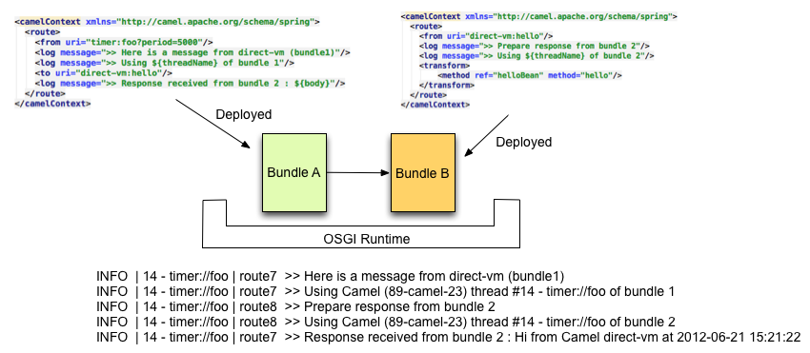
Camel Components – Direct-VM
The Direct-Vm component provides direct, synchronous invocation of any consumers in the JVM when a producer sends a message exchange.
This endpoint can be used to connect existing routes in the same camel context, as well from other camel contexts in the same JVM.
URI Format:
direct-vm:uniqueRouteName[?options]
https://camel.apache.org/components/latest/direct-vm-component.html

Slide 6
Camel Components – Direct-VM
Options available with component:
bridgeErrorHandler
block
lazyStartProducer
Timeout
Example:
<route>
<from uri="activemq:queue:order.in"/>
<to uri="bean:orderService?method=validate"/>
<to uri="direct-vm:processOrder"/>
</route>
<route>
<from uri="direct-vm:processOrder"/>
<to uri="bean:orderService?method=process"/>
<to uri="activemq:queue:order.out"/>
</route>

Slide 7
Camel Components – SEDA
The SEDA [Staged Event-Driven Architecture] component provides asynchronous SEDA behavior, so that messages are exchanged on a BlockingQueue and consumers are invoked in a separate thread from the producer.
SEDA implementation mechanism avoids the high overhead associated with thread-based concurrency models (i.e. locking, unlocking, and polling for locks), and decouples event and thread scheduling from application logic.
Note that queues are only visible within a single CamelContext.
This component does not implement any kind of persistence or recovery, if the VM terminates while messages are yet to be processed. If business need persistence, reliability or distributed SEDA, try using either JMS or ActiveMQ.
URI Format:
seda:uniqueRouteName[?options]
https://camel.apache.org/components/3.4.x/seda-component.html

Slide 8
Camel Components – SEDA …Continued
Options available with component:
Property Name | Default Value
size | 1000
consurrentConsumers | 1
limitConsurrentConsumers | true
multipleConsumers | false
pollTimeout | 1000
purgeWhenStopping | false
discardIfNoConsumer | false
discardWhenFull | false
queue | LinkedBlockingQueue

Slide 9
Camel Components – SEDA …Continued
Example:
Use of request Reply:
from("mina:tcp://0.0.0.0:9876?textline=true&sync=true").to("seda:input");
from("seda:input").to("bean:processInput").to("bean:createResponse");
Concurrent Consumers:
from("seda:stageName?concurrentConsumers=5").process(...)
Thread Pool:
from("seda:stageName").thread(5).process(...)
Choosing Blocking queue implementation:
<bean id="arrayQueue" class="java.util.ArrayBlockingQueue">
<constructor-arg index="0" value="10" ><!-- size -->
<constructor-arg index="1" value="true" ><!-- fairness -->
</bean>
<!– Configure the chosen queue implementation -->
<from>seda:array?queue=#arrayQueue</from>

Slide 10
Camel Components – Bean
The Bean component binds beans to Camel message exchanges.
Beans will be registered with Camel bean registry for future lookup.
A beanID can be any string which is used to look up the bean in the Registry.
URI format:
bean:beanName[?options]
https://camel.apache.org/components/latest/bean-component.html
Bean Options
method – Name of the bean method to invoke
scope – scope of the bean, default Singleton

Slide 11
Camel Components – Bean …Continued
BEAN AS ENDPOINT
Camel also supports invoking Bean as an Endpoint. In the route below:
What happens is that when the exchange is routed to the defined Bean Camel will use the Bean Binding to invoke the bean.
The source for the bean is just a plain POJO:
Camel will use Bean Binding to invoke the Bean’s method, by converting the Exchange’s In body to the String type and storing the output of the method on the Exchange Out body.
Example:
Java DSL comes with syntactic sugar for the Bean component. Instead of specifying the bean explicitly as the endpoint (i.e. to("bean:beanName")) you can use the following syntax:
// Send message to the bean endpoint
// and invoke method resolved using Bean Binding.
from("direct:start").bean("beanName");
// Send message to the bean endpoint
// and invoke given method.
from("direct:start").bean("beanName", "methodName");

Slide 12
Camel Components – Log
The Log component logs message exchanges to the underlying logging mechanism.
Camel uses sfl4j which allows you to configure logging via, among others:
Log4j
Logback
Java Util Logging
URI Format:
log:loggingCategory[?options]
Where loggingCategory is the name of the logging category to use.
https://camel.apache.org/components/3.4.x/log-component.html
log:org.apache.camel.example?level=DEBUG
from("activemq:orders")
.to("log:com.mycompany.order?level=DEBUG")
.to("bean:processOrder");

Slide 13
Camel Components – Log …Continued
Log EIP:
The log DSL is much lighter and meant for logging human logs such as Starting to do …​ etc.
It can only log a message based on the Simple language.
On the other hand Log component is a full fledged component which involves using endpoints and etc.
The Log component is meant for logging the Message itself and you have many URI options to control what you would like to be logged.
https://camel.apache.org/components/3.7.x/eips/log-eip.html
from("direct:start")
.log("Processing record with ID: ${id}")
.log(LoggingLevel.DEBUG, "Processing same record with ID: ${id}")
.to("bean:foo");
Note: If the message body is stream based, then reading message once will empties the body from further use.

Slide 14
Camel Components – File
The File component provides access to file systems, allowing files to be processed by any other Camel Components or messages from other components to be saved to disk.
To prevent reading files which are currently being written by some other application/process, Camel provides different readLock options and doneFileName option that you can use.
URI Format:
file:directoryName[?options]
-or-
file://directoryName[?options]
Where directoryName represents the underlying file directory.
https://camel.apache.org/components/latest/file-component.html

Slide 15
Camel Components – File …Continued
Options available:
charset
doneFIleName
filename
delete
noop
preMove
presort
Recursive
sendEmptyMessageWhenIdle
fileExist
chmod
keepLastModified
bufferSize [131072]
Idempotent [false]
readLock

Slide 16
Camel Components – File …Continued
Example#1:
onException(IOException.class).handled(true)
.log("IOException occurred due: ${exception.message}")
.transform().simple("Error ${exception.message}")
.to("mock:error");
from("file:inbox?charset=utf-8")
.convertBodyTo(byte[].class, "iso-8859-1")
.to("bean:myBean")
.setProperty(Exchange.CHARSET_NAME, header(“US-ASCII”))
.setHeader("CamelFileName", constant("report.txt"))
.to("file://outbox/reports?doneFileName=${file:name}.done");
Example#2:
<route>
<from uri="file://inbox?idempotent=true&amp;idempotentRepository=#jpaStore"/>
<to uri="bean:processInbox"/>
</route>

Slide 17
Thank You

